Slide 1
Rheology of Viscoelastic surfactants and foam in homogeneous porous media
Aarthi Muthuswamy, Clarence Miller, Rafael Verduzco and George Hirasaki
Chemical and Biomolecular Engineering, Rice University
April 23rd, 2012
16th Annual Meeting
Consortium for Processes in Porous Media

Slide 2
Scope of study
Polymers are very good mobility control agents
Polymers tend to degrade
High shear
High salinity
Presence of divalent ions
High temperature.

Slide 3
Outline
Aqueous properties of Rhodia’s viscoelastic surfactants
Rheological measurements for viscoelasticity
-Rhodia A in sea water
-Rhodia B in sea water
Foam –experimental set up
Foam measurements(screening tests)
-Foam measurements for Rhodia A
-Foam measurements for Rhodia B
Remarks
Future work

Slide 4
Outline
Aqueous properties of Rhodia’s viscoelastic surfactants
Rheological measurements for viscoelasticity
-Rhodia A in sea water
-Rhodia B in sea water
Foam –experimental set up
Foam measurements(screening tests)
-Foam measurements for Rhodia A
-Foam measurements for Rhodia B
Remarks
Future work

Slide 5
Viscosity for 0.3 wt% Rhodia ‘A’ in aqueous solution
Viscosity enhances due to the presence of divalent calcium and magnesium salts

Slide 6
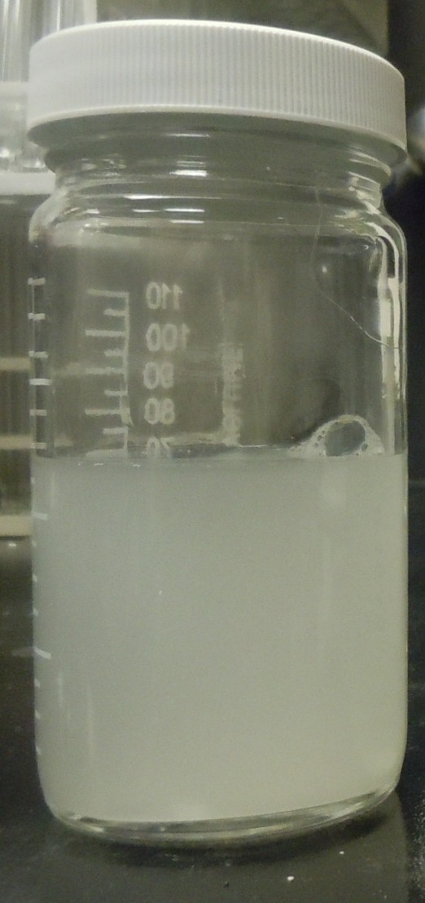
Appearance of Rhodia ‘B’ 0.3 wt% in DI water after 7 days
Cloudy appearance is noticed.

Slide 7
Birefringence in Rhodia ‘B’
Original sample
0.3 wt% in DI water after 7 days

Slide 8
Viscosity for 0.3 wt% Rhodia ‘B’ in aqueous solution
The viscosity is not affected by the presence of divalent salts

Slide 9
Outline
Aqueous properties of Rhodia’s viscoelastic surfactants
Rheological measurements for viscoelasticity
-Rhodia A in sea water
-Rhodia B in sea water
Foam –experimental set up
Foam measurements(screening tests)
-Foam measurements for Rhodia A
-Foam measurements for Rhodia B
Remarks
Future work

Slide 10
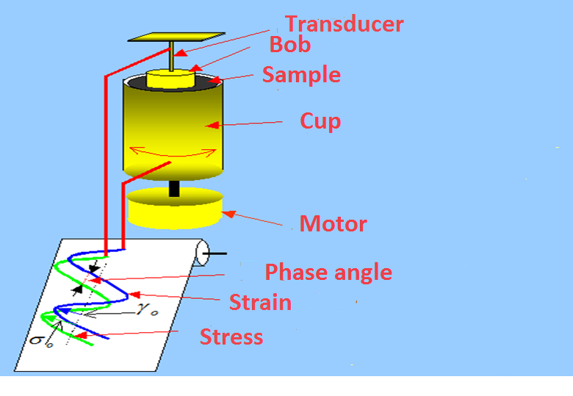
Phase angle measurement
δ
γ
σ
Courtesy :Introduction to Rheology- Texas Tech University

Slide 11
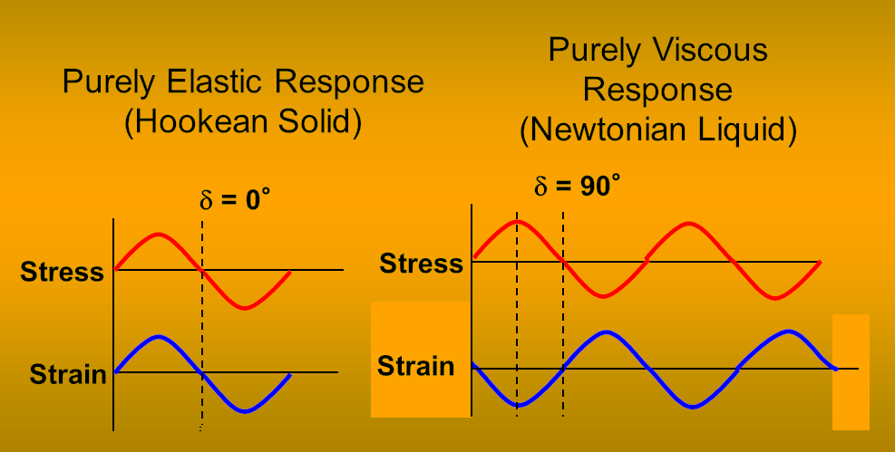
Phase angle measurement for elastic and viscous substances
Courtesy :Introduction to Rheology- Texas Tech University

Slide 12
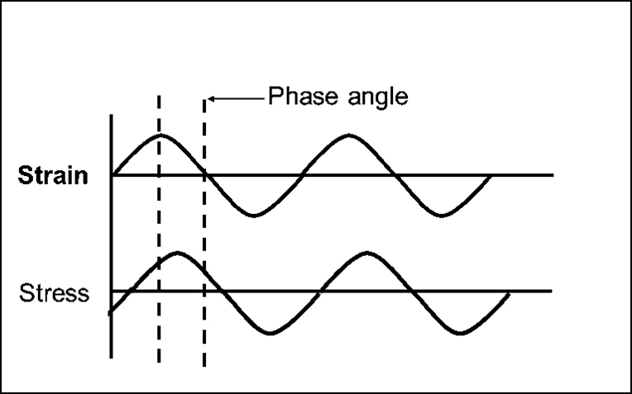
Phase angle measurement for Viscoelasticity
0°<δ< 90°
Courtesy :Introduction to Rheology- Texas Tech University

Slide 13
Rhodia ‘A’ 1wt% in sea water
The elastic modulus dominates after a frequency of 8.5 rad/s
Relaxation time is ~0.5 seconds.

Slide 14
Rhodia ‘A’ 1 wt% in sea water- Phase Angle
Phase angle measurement lie within 0-90° indicating it is viscoelastic

Slide 15
Rhodia A 1wt% in sea water- viscosity
The zero shear viscosity reaches ~300cP

Slide 16
Rhodia B 1 wt% in sea water
Elastic modulus dominates throughout the range of study showing how viscoelastic the fluid is
Relaxation time is ~ 3 seconds.

Slide 17
Rhodia B 1wt% in sea water- Phase Angle
Phase angle measurement lie within 0-90° showing viscoelastic behavior

Slide 18
Rhodia B 1 wt% in sea water- viscosity
Zero shear viscosity predicted by the Carreau model gives a value of ~4000cP

Slide 19
Outline
Aqueous properties of Rhodia’s viscoelastic surfactants
Rheological measurements for viscoelasticity
-Rhodia A in sea water
-Rhodia B in sea water
Foam –experimental set up
Foam measurements (screening tests)
-Foam measurements for Rhodia A
-Foam measurements for Rhodia B
Remarks
Future work

Slide 20
Foam experimental set up
Inlet
Outlet
Stainless steel sand pack
Co-Injection
Taps
Taps
Transducer
Syringe Pump
Transducer
Transducer
Sand: US silica 20-40
Porosity 0.36
Permeability ~80 Darcy
Nitrogen gas

Slide 21
Foam Experiment – Rhodia B
Tap 1 midpoint 6 inch from inlet
Tap 2 midpoint 12 inch from inlet
outlet
inlet
Overall ~24 inch
Tap 2
6 inch
Tap 1
6 inch
Clean sand US silica 20-40 mesh
Porosity 0.36
Permeability ~ 80 Darcy
1 wt% in sea water
Foam quality ~83%
Surfactant flow rate 1.2cc/min
Gas flow rate 6 sccm

Slide 22
Foam Experiment – Rhodia A
outlet
inlet
Overall ~24 inch
Tap 2
6 inch
Tap 1
6 inch
Sand from previous experiment was cleaned and used.
1 wt% in sea water
Foam quality ~83%
Surfactant flow rate 1.2cc/min
Gas flow rate 6 sccm

Slide 23
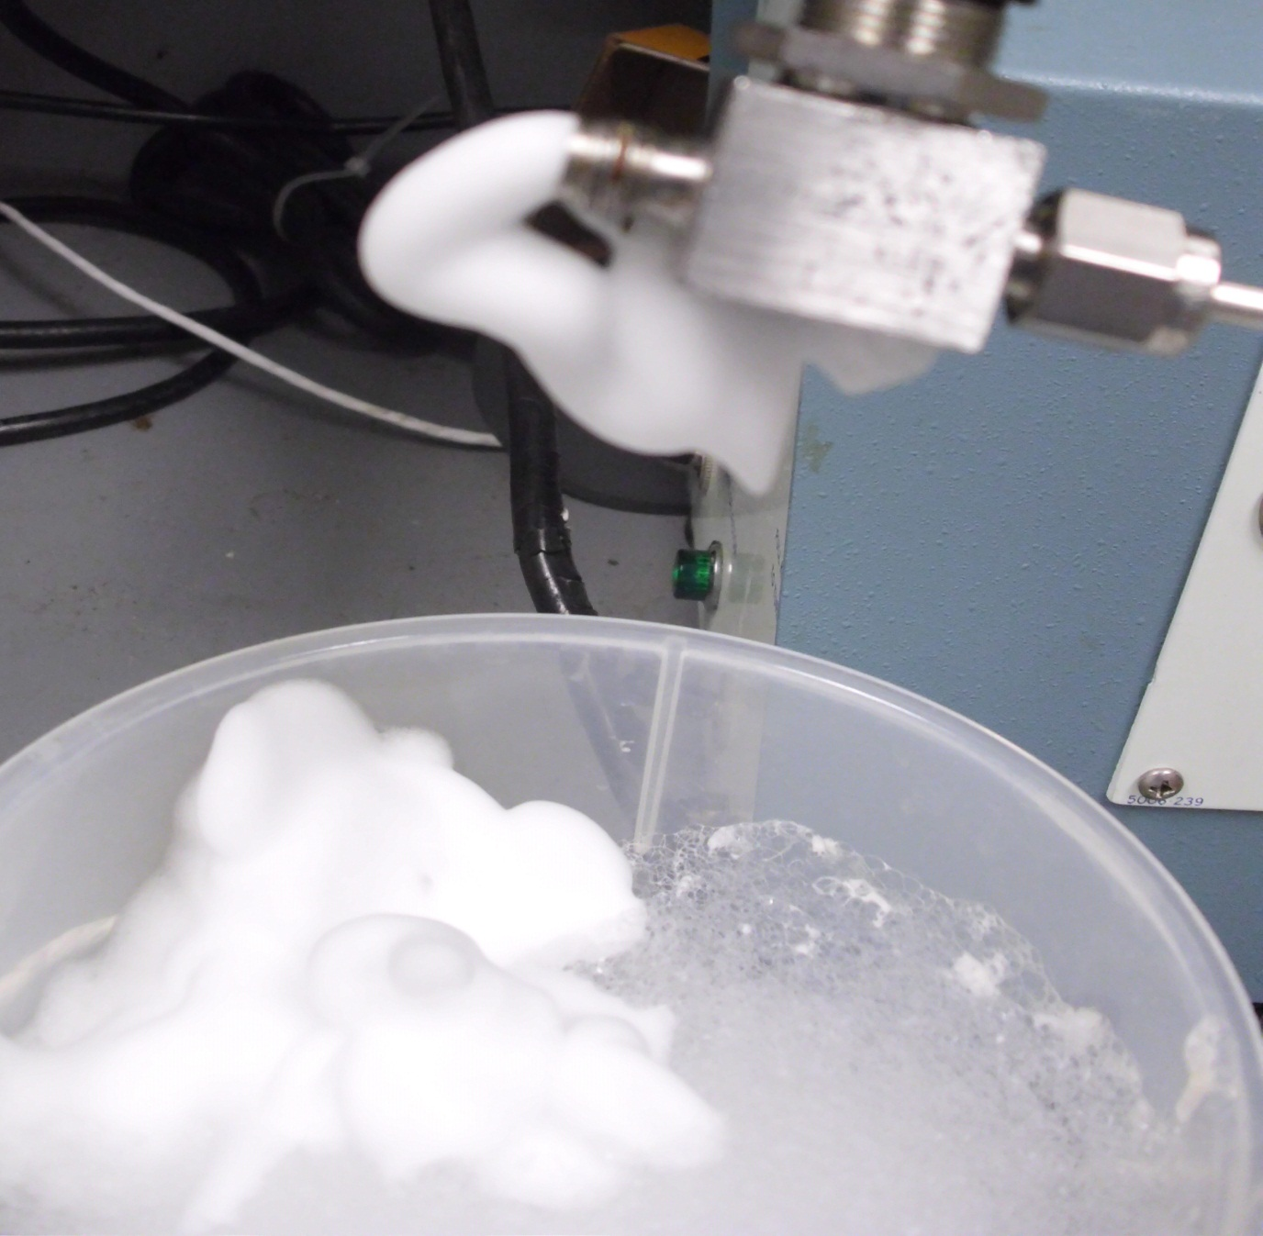
Effluent of foam generated by Rhodia B

Slide 24
Remarks
Rhodia B is more viscoelastic at 1wt% in sea water compared to Rhodia A at same conditions.
The zero shear viscosity of Rhodia A ~ 300cP
The zero shear viscosity of Rhodia B ~ 4000cP
Rhodia A and B foam strongly in homogeneous porous media

Slide 25
Future work
Systematic analysis for the tolerance of these surfactants in the presence of oil.
Conditions under which these surfactants maintain viscoelasticity (temperature, salinity and divalent ion concentration).
Foaming ability of Rhodia viscoelastic surfactants in carbonates using CO₂
Foam enhanced oil recovery for high salinity and temperature in cores.

Slide 26
Acknowledgement
Maura Puerto
Jose Lopez Salinas
Matteo Pasquali
Processes on Porous media consortium
Rhodia

Slide 27
END

Slide 28
Backup Slides

Slide 29
Fit the complex viscosity from Maxwell model – Rhodia A

Slide 30
Fit the complex viscosity from Maxwell model – Rhodia B

Slide 31
Ratio of pressure drops for Rhodia A and B
Rhodia A
Rhodia B

Slide 32
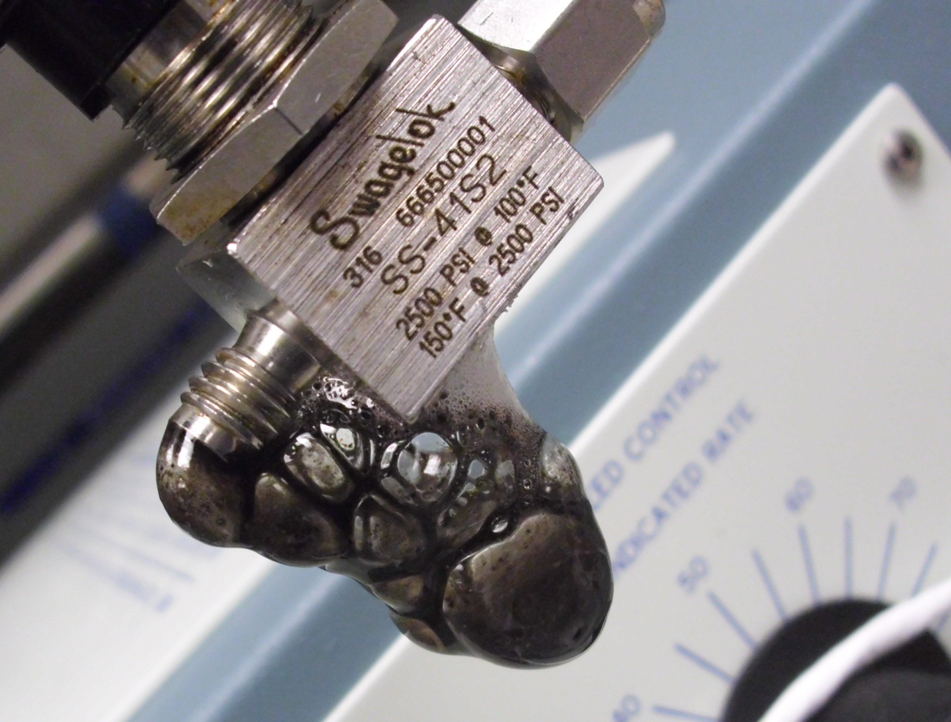
Rhodia B effluent foam in the presence of oil

